Slide 1
BugProof
QFT-based controller design tools:
Properties, capabilities, and examples
2025 IAAC Control Conference (IAAC3),
April 28, 2025.
Oded Yaniv
    The QFT methodology was developed by Prof. Yitzhak Horowitz, ז"ל
    Dr. Marcel Sidi (ז"ל)contributed greatly in the early stages and over the years.

Slide 2
Before the Lecture
Almost a year ago, I was invited to give a lecture at Elbit Systems Ramat Hasharon, on QFT design tools
About six months ago, Per-Olof asked me to talk at this conference, … I had a lecture prepared
However, it is not a new material…
To still provide something new, I’ll add some personal insights for loaded motors applications, which should be appreciated by mechanical designers as well as control engineers.

Slide 3
Why QFT and why QFD based Software
QFT is a theory for designing controllers. It emphasizes industrial common specifications:
Gain-Margin and Phase-Margin
Robustness to a given set of multiple modes (no overdesign → crucial when performance matters). Overdesign = There exists a more effective controller that requires less control effort
Overshoot / Time domain specs
Control Efforts
Sensors’ noise reduction
Scheduling
Use analytic models as well as measured data
And many more …

Slide 4


The Idea Behind the QFT based Software
Calculate “all” controllers that satisfy design specifications
then pick the “best”
Example: All PD controllers are set of pairs (KP,KD)
The software calculates its surface using a formula
$$ω→\left(KP,KD\right)$$
The same is true for PID controllers (KI,KP,KD)
The software calculates its surface
$$ω→\left(KI,KP,KD\right)$$
It takes 3-15 milliseconds to calculate 4000 controllers on the surface of a PID controller

Slide 5
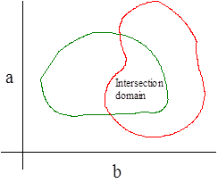
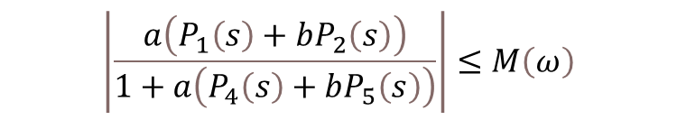

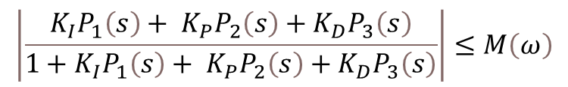
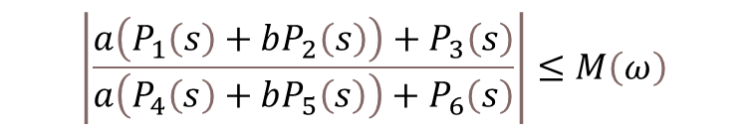
Theory in a nutshell
Consider the following bilinear equation
$$\left|\frac{a\left(P_{1}\left(s\right)+bP_{2}\left(s\right)\right)+P_{3}\left(s\right)}{a\left(P_{4}\left(s\right)+bP_{5}\left(s\right)\right)+P_{6}\left(s\right)}\right|≤M\left(ω\right)$$
$$\left|\frac{a\left(P_{1}\left(s\right)+bP_{2}\left(s\right)\right)}{1+a\left(P_{4}\left(s\right)+bP_{5}\left(s\right)\right)}\right|≤M\left(ω\right)$$
A non-iterative algorithm to find the surface of all true pairs exists
$$\left(a,b\right)$$
Extension to three parameters (Proposed by Yahali Theodor)
$$\left|\frac{K_{I}P_{1}\left(s\right)+ K_{P}P_{2}\left(s\right)+K_{D}P_{3}\left(s\right)}{1+K_{I}P_{1}\left(s\right)+ K_{P}P_{2}\left(s\right)+K_{D}P_{3}\left(s\right)}\right|≤M\left(ω\right)$$
Extension to more than three parameters (I wrote software up to 6)
Extension to add low-pass, notch, lead, lag, etc.

Slide 6
Why is “All Controllers” Strategy so Important?
The designer does not miss a good controller. This is crucial, as better performance can be achieved at no extra cost.
      Please don’t underestimate this!
Speed up the design process (list from strong to weak and …)
Speed up the analysis process (choosing sensors, finding the best architecture, delay impact on performance, stiffness, resonance and/or antiresonance values, etc.)
Easy to pick the “best” controller according to different criteria
Makes scheduling possible and easy:
  From the pool of controllers for each flight condition, choose the best controller that satisfies the specs and is changed slowly enough along the flight trajectory
Enhances the professional skills of the control engineer and frees up the time for other tasks

Slide 7
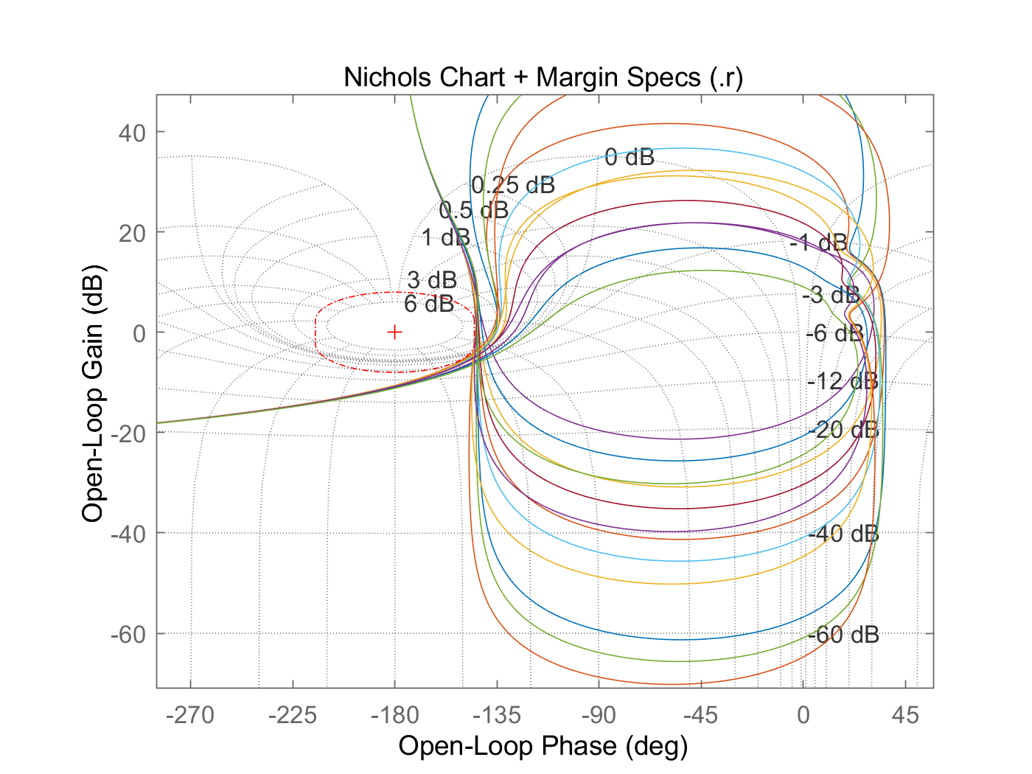
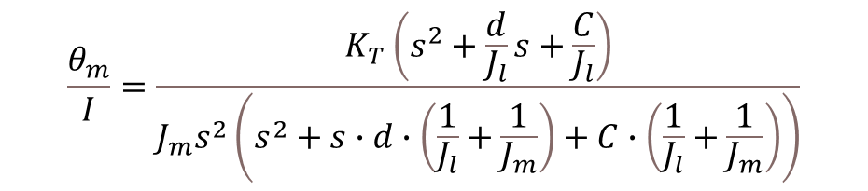
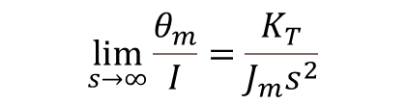
Some observations for Loaded Motors
Motor angle to current for a loaded motor (simplest model)
$$\frac{θ_{m}}{I}=\frac{K_{T}\left(s^{2}+\frac{d}{J_{l}}s+\frac{C}{J_{l}}\right)}{J_{m}s^{2}\left(s^{2}+s∙d∙\left(\frac{1}{J_{l}}+\frac{1}{J_{m}}\right)+C∙\left(\frac{1}{J_{l}}+\frac{1}{J_{m}}\right)\right)}$$
$$\lim_{s→∞}{\frac{θ_{m}}{I}}=\frac{K_{T}}{J_{m}s^{2}}$$
Load, damping, and stiffness uncertainty disappear
If the open-loop second crossover frequency exceeds twice the resonance, then the uncertainty to motor parameters reduces to the gain 1/Jm

Slide 8
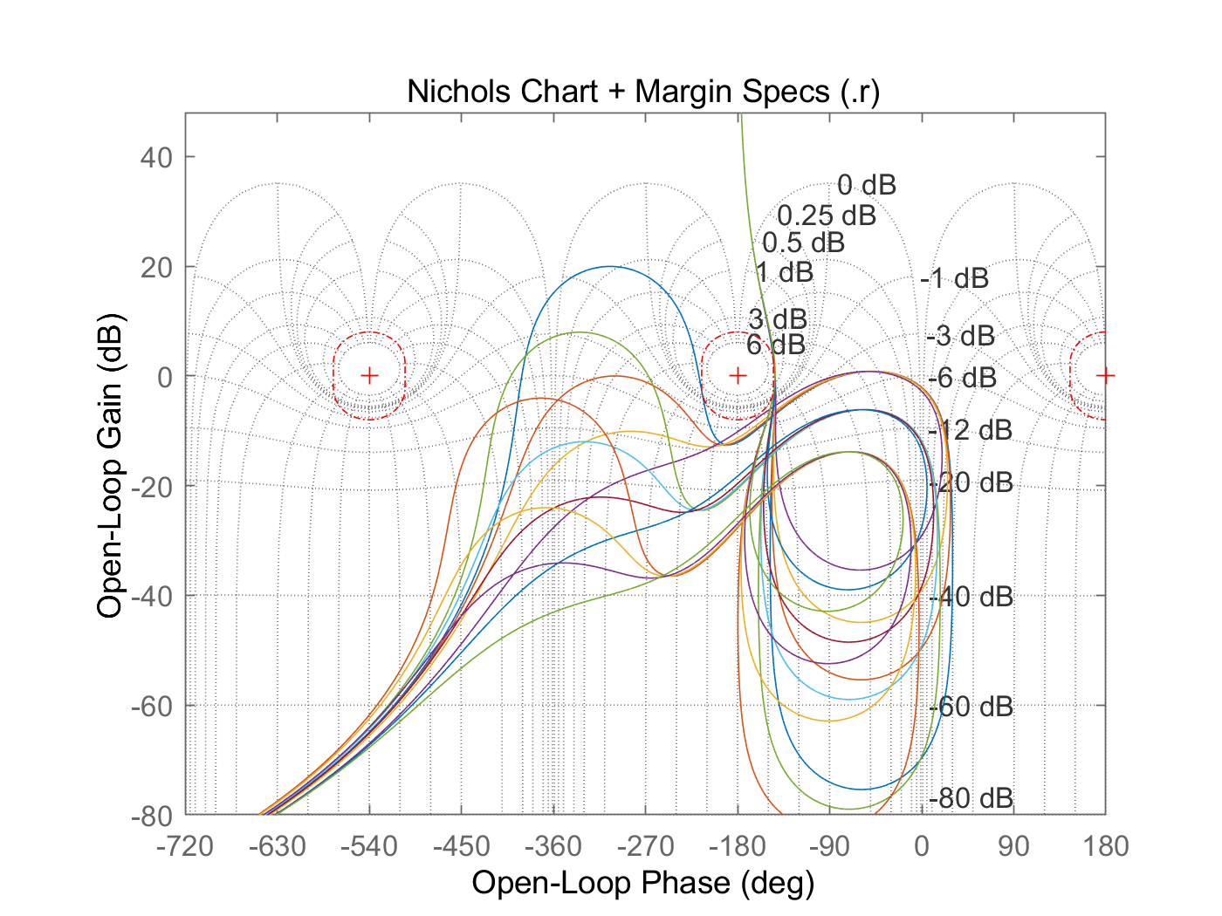
Some observations for Loaded Motors
Cross-over<resonance: The main problem is stiffness uncertainty

Slide 9
Example: Fix Measured Models
Blue: Identification, flat in amplitude and phase in [100 1000]
Therefore phase must be 0. It has to be corrected!
Red: Corrected identification based on loaded-motor model
This correction was verified by closed-loop margin measurements to less than 10deg accuracy

Slide 10
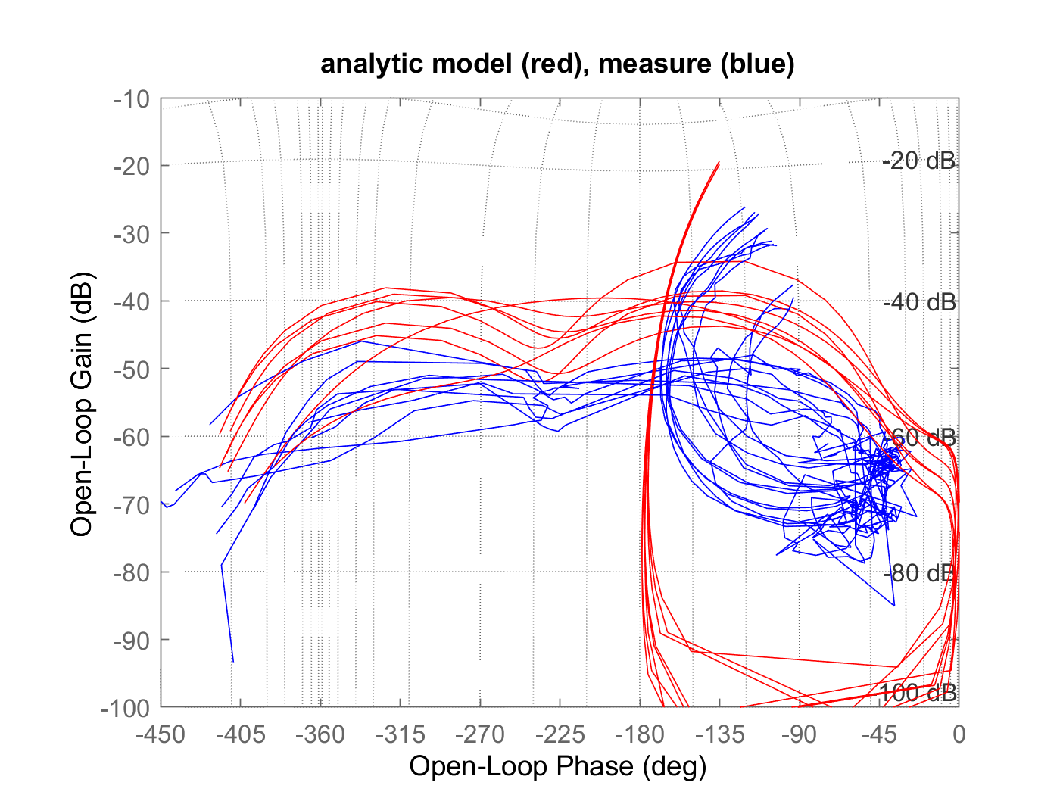
… and how it looks on the Nichols chart
Blue: Identification
Red: Corrected

Slide 11
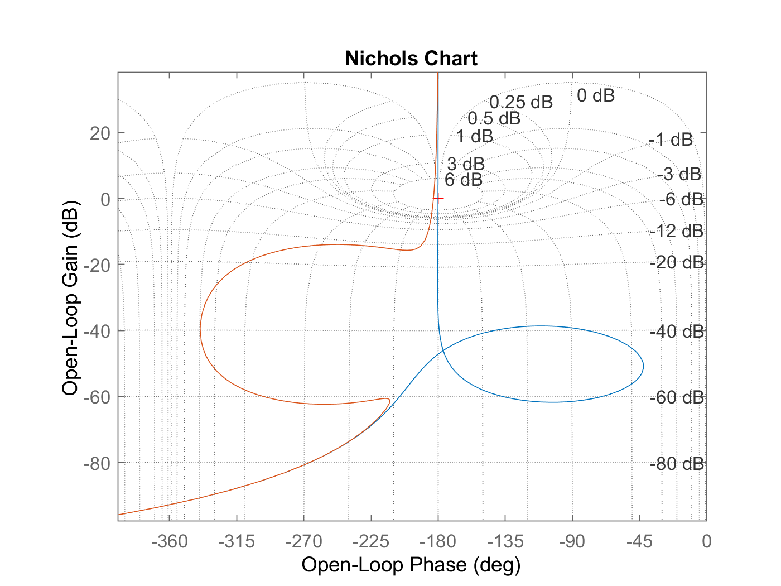

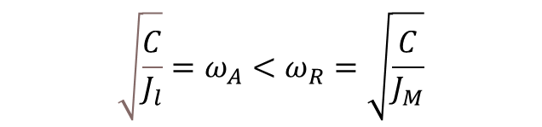

One More Important Observation …
$$\frac{θ_{m}}{I}=\frac{K_{T}\left(s^{2}+\frac{d}{J_{l}}s+\frac{C}{J_{l}}\right)}{J_{m}s^{2}\left(s^{2}+s∙d∙\left(\frac{1}{J_{l}}+\frac{1}{J_{m}}\right)+C∙\left(\frac{1}{J_{l}}+\frac{1}{J_{m}}\right)\right)}$$
$$\sqrt{\frac{C}{J_{l}}}=ω_{A}<ω_{R}=\sqrt{\frac{C}{J_{M}}}$$
I have seen “special” motors, where
This is a very bad technology! because it dramatically reduces the closed-loop bandwidth.
$$ω_{A}>ω_{R}$$
This phenomenon might occur when there is more than one load → Mechanical designers should be careful when designing the mechanics.

Slide 12
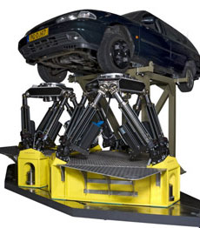
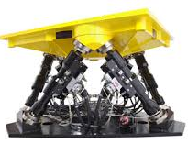
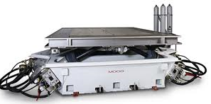
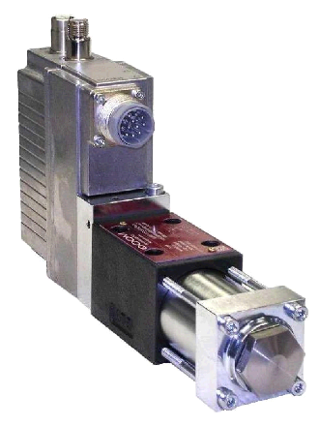
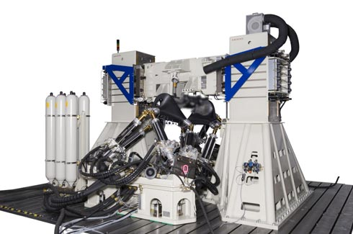
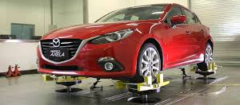
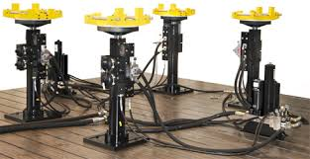
MOOG NEDERLAND
S. Mollov: all feedback designs in applications where performance matters are using QFT ($50M turn-over/year)

Slide 13
Example Pitch control (AoA)
Plant given by its state-space model {a,b,c,d}
Actuator dynamic = w/(s+w), w=20.2 rad/s
Plant delay=0.2 sec.
Sensors: AoA, dot_AoA.
Actuator: Elevator control surface
Tolerances:
  +30% to -50% on nominal Cma (=a(4,3))
  +50% to -50% on nominal Cmq (=a(4,4))
  +30% to -30% on nominal Cmde (=a(4,5))
Design AoA controller with the following constraints:
  Upper GM=10.5dB, lower GM=6dB, PM=45
  Steady state error = 0 {use integrator}
  Loop BW = 3 rad/sec
  Max overshoot less than 20%
  Closed loop with damping ratio better than 0.4

Slide 14
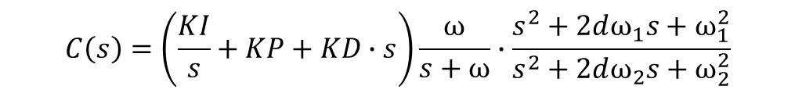
Example: Pitch control Cont.
The outcome of the design tool is a list of controllers:
$$C\left(s\right)=\left(\frac{KI}{s}+KP+KD∙s\right)\frac{ω}{s+ω}∙\frac{s^{2}+2dω_{1}s+ω_{1}^{2}}{s^{2}+2dω_{2}s+ω_{2}^{2}}$$
A solution exists if the delay <= 0.05sec.
This limitation is theoretical

Slide 15
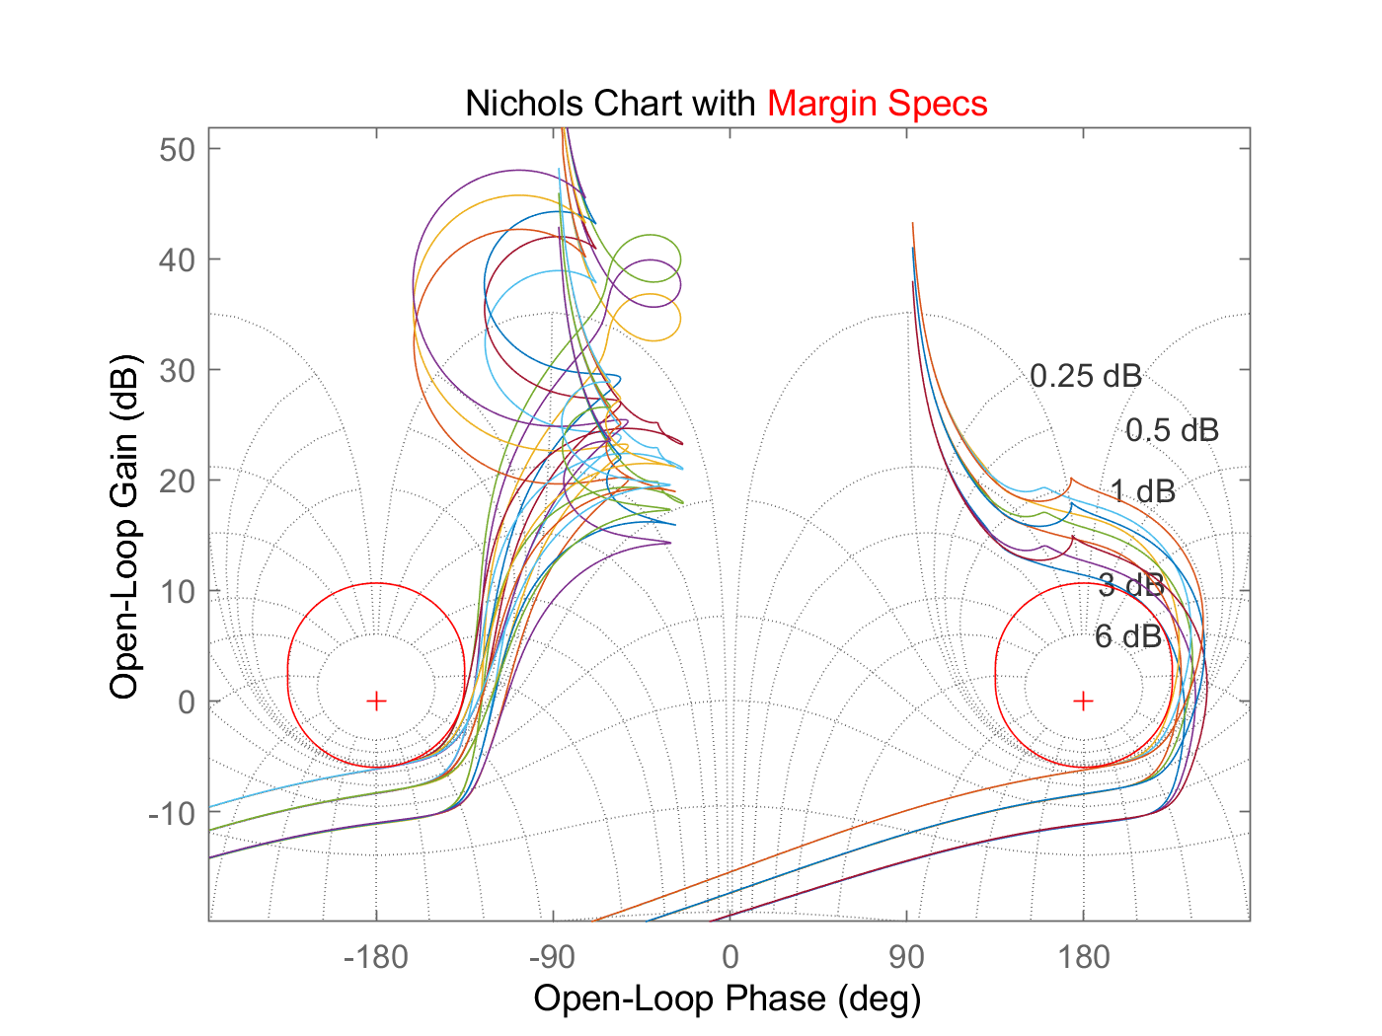
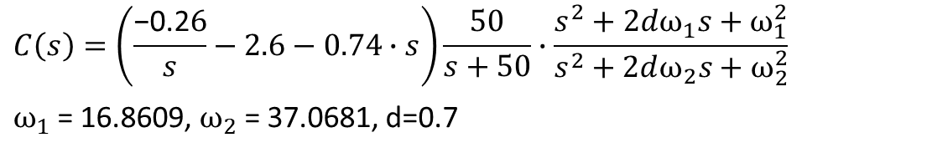
Example: AoA – Visualizing a controller
$$C\left(s\right)=\left(\frac{\text{−}\text{0}\text{.}\text{2}6}{s}−2.6−0.74∙s\right)\frac{50}{s+50}∙\frac{s^{2}+2dω_{1}s+ω_{1}^{2}}{s^{2}+2dω_{2}s+ω_{2}^{2}}$$
$ω_{1}$= 16.8609, $ω_{2}$= 37.0681, d=0.7

Slide 16
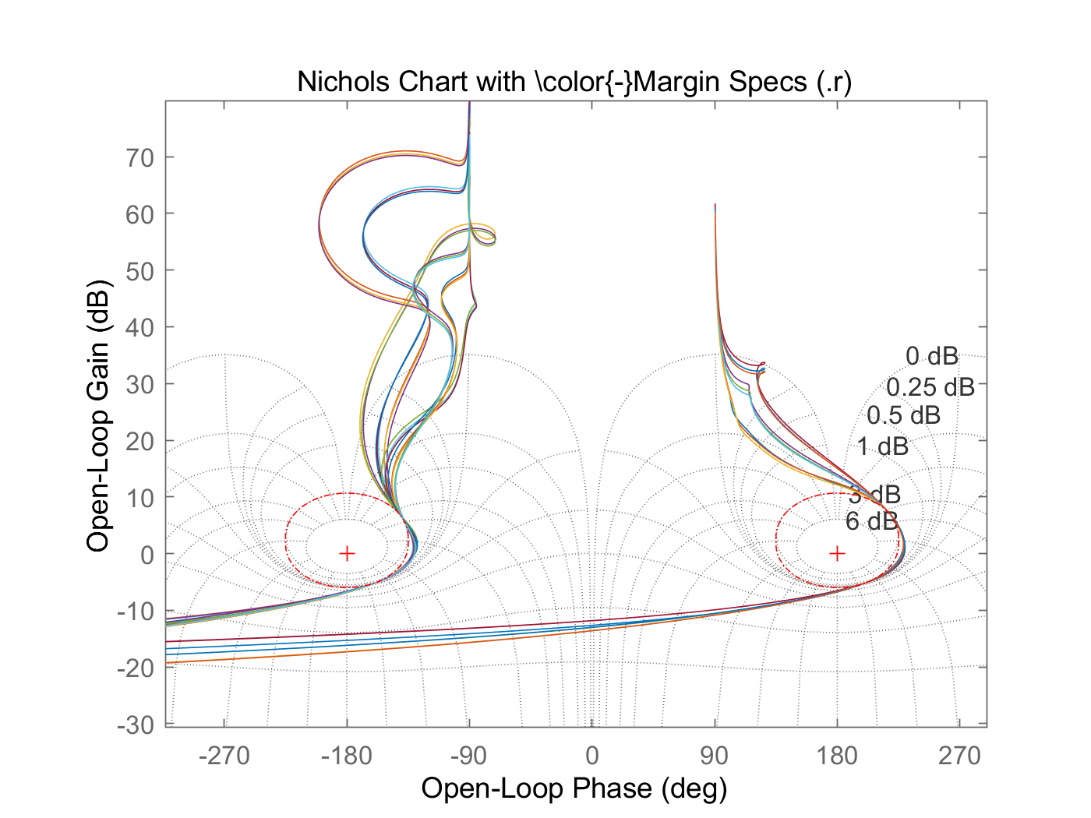
Scheduling: Pitch control
The QFT software fits scheduled controllers because:
  The control architecture can be fixed
  Parameters can be constrained to a given range to ensure gradual changes during operation
A scheduled controller exists for delay = 0.05 A robust controller exists for delay = 0.11

Slide 17
What to Expect from MIMO Feedback Systems
Tradeoff between channels

Slide 18
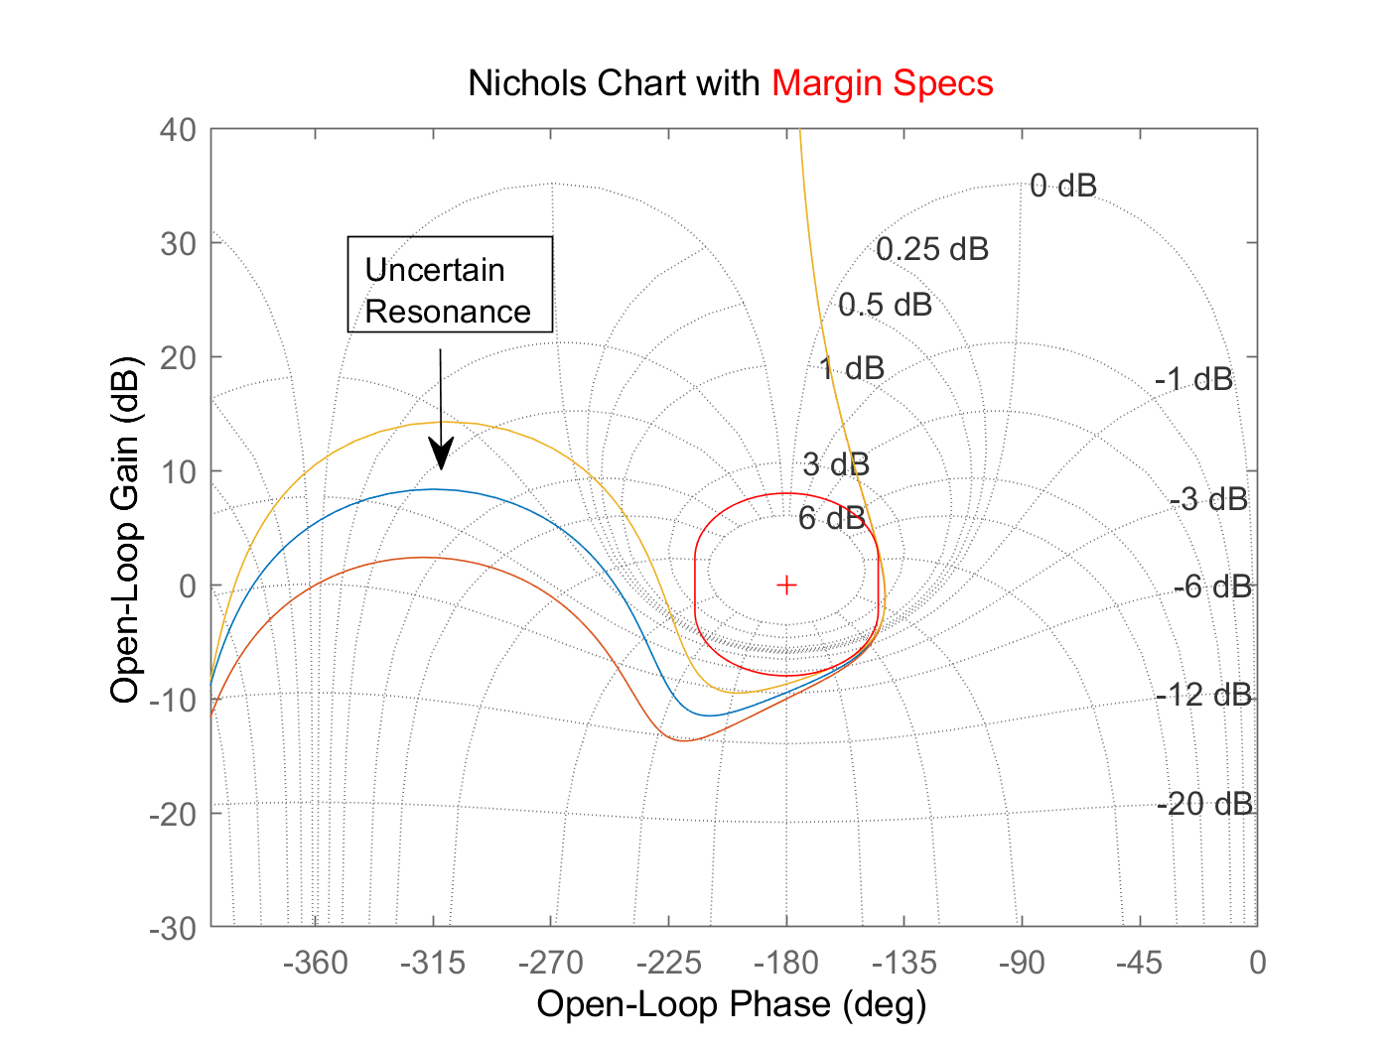
Why Use Nichols Chart for Presenting the Open Loop?
Locate resonances in a non-sensitive phase to be less sensitive to uncertainty
Uncertainty analysis (sensitivity and identification)

Slide 19
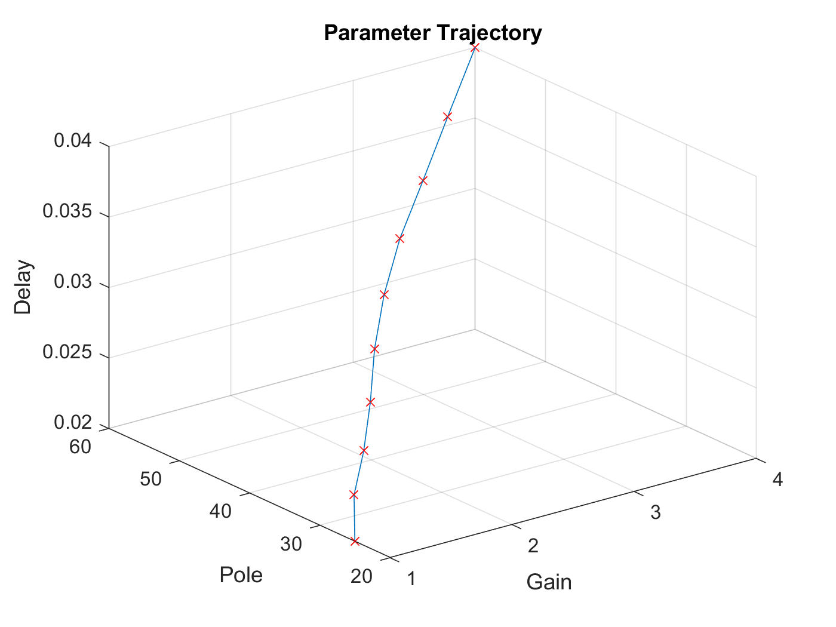
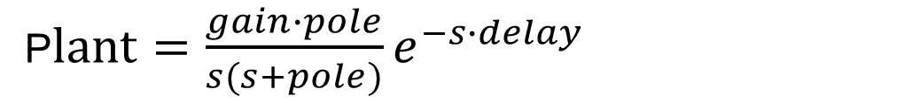
Cooked UP Example
P$lant=\frac{gain∙pole}{s(s+pole)}e^{−s∙delay}$

Slide 20
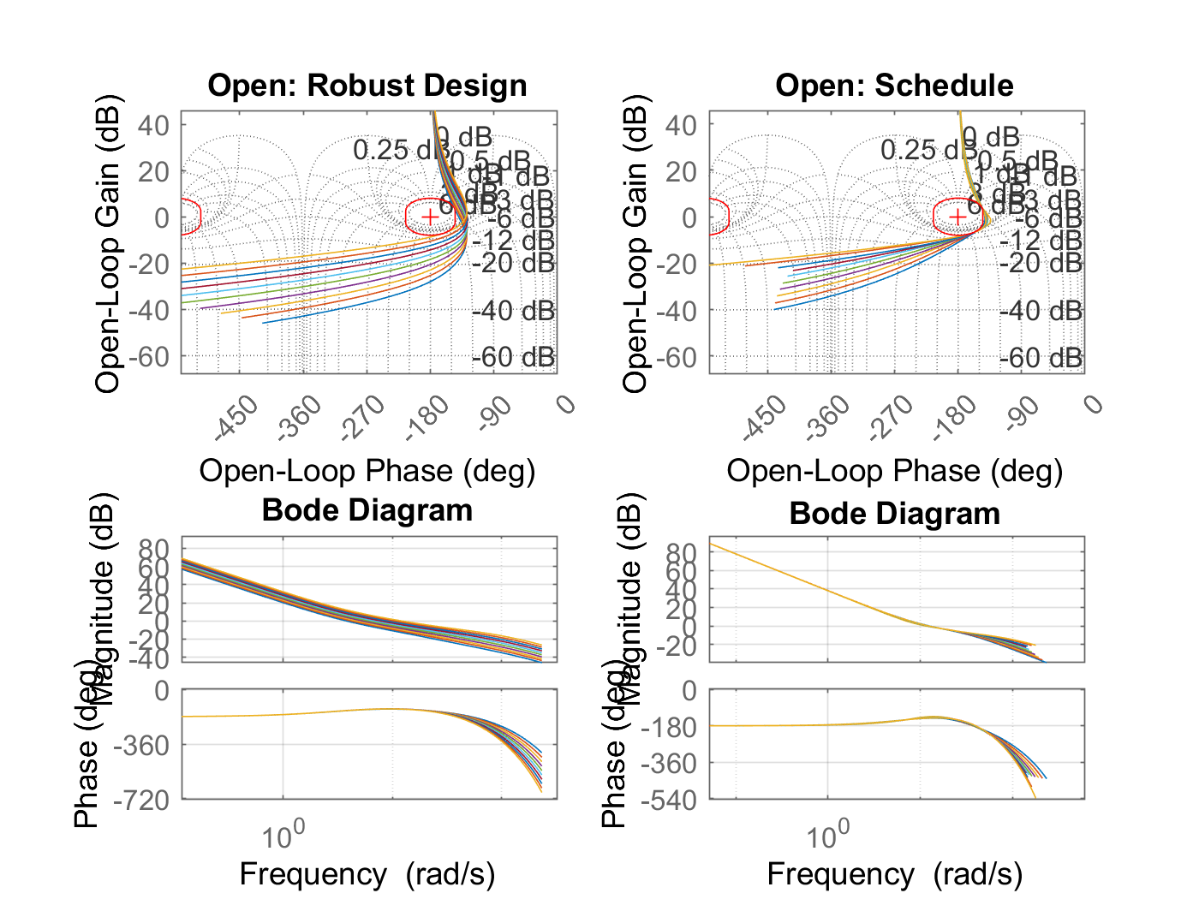
Cont.

Slide 21
Thanks

Slide 22
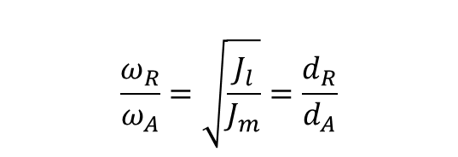
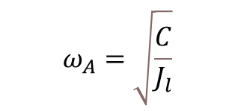
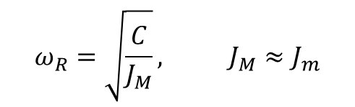
Some Insights for Loaded Motors
$$\frac{ω_{R}}{ω_{A}}=\sqrt{\frac{J_{l}}{J_{m}}}=\frac{d_{R}}{d_{A}}$$
$$ω_{A}=\sqrt{\frac{C}{J_{l}}}$$
$$ω_{R}=\sqrt{\frac{C}{J_{M}}}, J_{M}≈J_{m}$$

Slide 23
Continue …
It simplifies the design process and understanding system’s behavior
Helps the designer understand where to locate low-pass, lead/lag, and notch filters
Understand the tradeoff between low-pass filters and notch filters

