Slide 1
Adaptive Current Control Method
By Yaron Zimmerman
April 2025

Slide 2
Motivation & Problem
DCBL coil resistance varies with temperature (up to 50%)
Affects closed-loop current control performance
Traditional PI controllers fail under low sample rates or fast dynamics

Slide 3
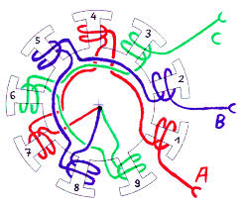
Introduction for current control
O

Slide 4
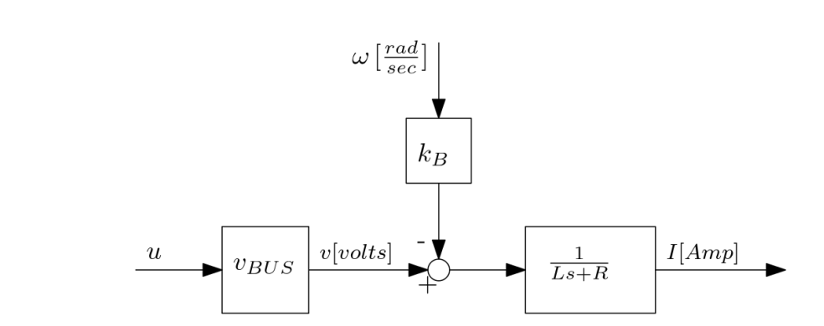
Model
$P\left(s\right)=\frac{V_{bus}}{Ls+R}$
$C\left(s\right)=k_{P}\left(1+\frac{k_{I}}{s}\right)$
$$k_{I}=R/L$$
$$k_{p}=\frac{ω_{c}L}{V_{bus}}$$
$L\left(s\right)=\frac{ω_{c}}{s}$ $G\left(s\right)=\frac{ω_{c}}{s+ω_{c}}$

Slide 5
Why Estimation is Needed
Large resistance variations break traditional tuning
Online estimation allows dynamic gain adjustment

Slide 6
Proposed Solution
Online estimation of coil resistance using Kalman Filters
Adaptive tuning of PI controller gain (kI)
Modeling based on coupled electrical and thermal dynamics

Slide 7
Dynamics modeling
$\dot{I}L+IR=V_{bus}u−k_{B}ω$
$R\left(T\right)=R_{0}+α(T−T_{0})$
$τ\dot{T}=−T+\frac{I^{2}R}{h}+T_{E}$
$$τ\dot{R}=−R+βI^{2}R+R_{E}$$
$$β=\frac{α}{h}$$
$$R_{E}=αT_{E}$$

Slide 8
State-Space Model
States: I, R, RE; Inputs: control voltage, speed
Includes process and measurement noise
Formulated for EKF/UKF estimation

Slide 9
Non-linear state functions
$x={\left[\begin{matrix}I & R & R_{E}\end{matrix}\right]}^{T}, u={\left[\begin{matrix}u & ω\end{matrix}\right]}^{T}$
$f(x,u)≡{\left[\begin{matrix}f_{1} & f_{2} & f_{3}\end{matrix}\right]}^{T}$
${\dot{x}}_{1}=f_{1}\left(x,u\right)=−\frac{x_{2}x_{1}}{L}+\frac{V_{bus}}{L}u_{1}−\frac{k_{BEMF}}{L}u_{2}$
${\dot{x}}_{2}= f_{2}\left(x,u\right)=−\frac{x_{2}}{τ}+\frac{βx_{2}x_{1}^{2}}{τ}+\frac{x_{3}}{τ}$
${\dot{x}}_{3}= f_{3}(x,u)=0$
$y=\left[\begin{matrix}1 & 0 & 0\end{matrix}\right]x+ν=hx+ν$

Slide 10
Approach Overview
Nonlinear state-space model with 3 states: current, resistance, env. Resistance
$\dot{x}=f\left(x,u\right)+w, Q=E\left\{ww^{T}\right\} Q_{D}≈\frac{Q}{T_{s}}$
$y=hx+ν$, $R_{D}=E\left\{ν⋅ν\right\}$
Use EKF and UKF for real-time estimation

Slide 11
Extended Kalman Filter (EKF)
Linearizes model at each step
Prediction and correction steps
Discretization via Jacobians

Slide 12
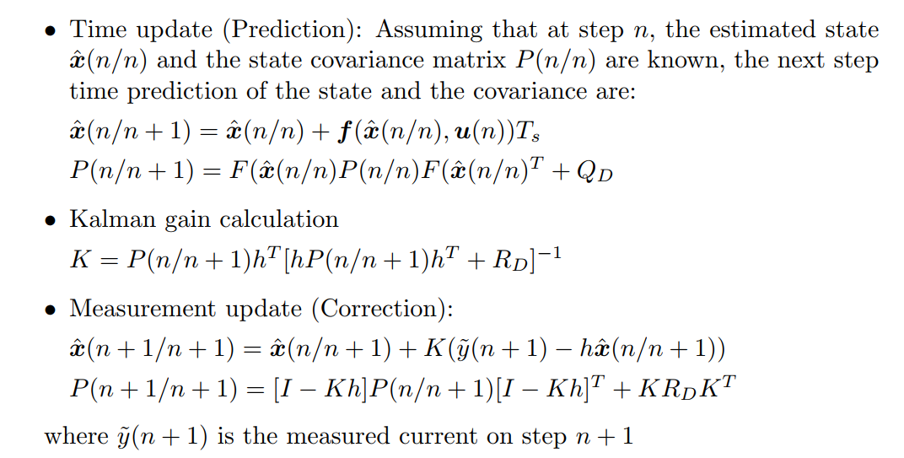
Extended Kalman Filter (EKF)

Slide 13
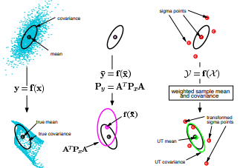
Unscented Kalman Filter (UKF)
Statistical linearization via sigma points
Better performance with nonlinear systems
More robust during transients

Slide 14
Unscented Kalman Filter (UKF)

Slide 15
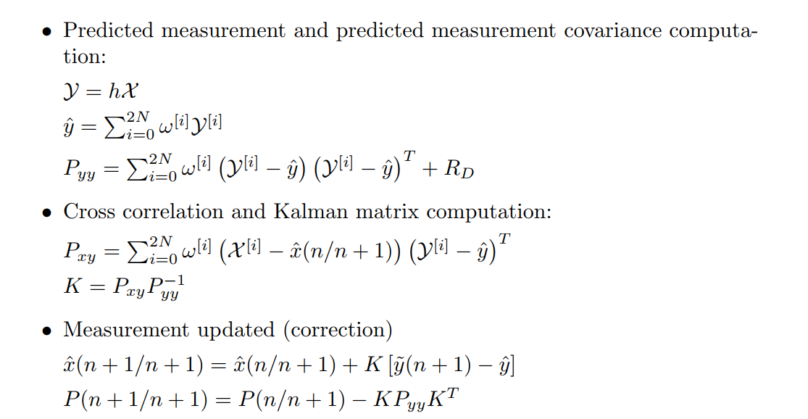
Unscented Kalman Filter (UKF)

Slide 16
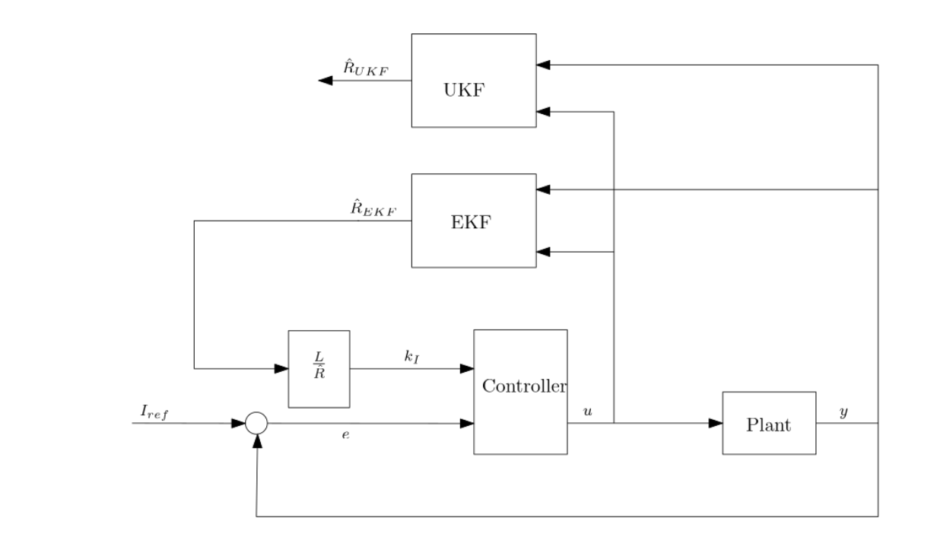
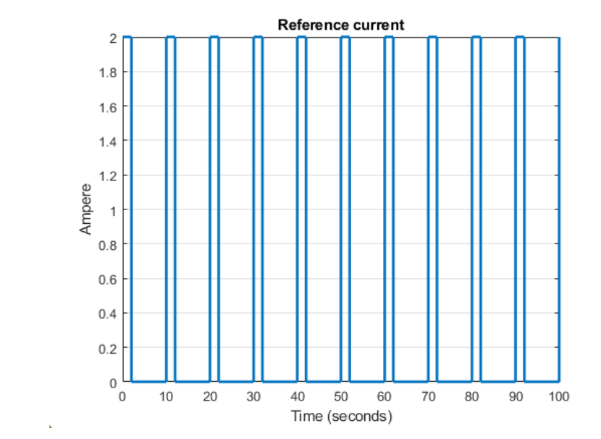
Simulation Setup
Square wave reference current input
Adaptive $k_{I} =\frac{L}{\hat{R }}$
Simulation parameters from paper

Slide 17
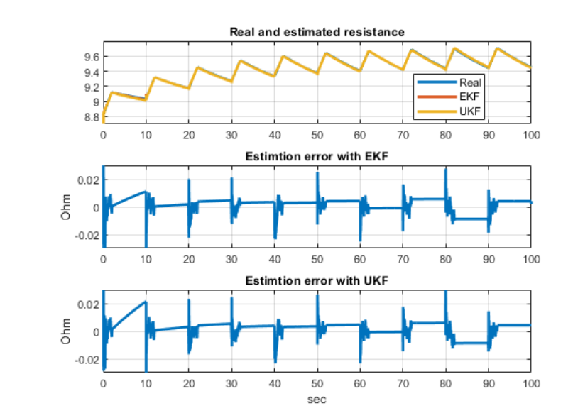
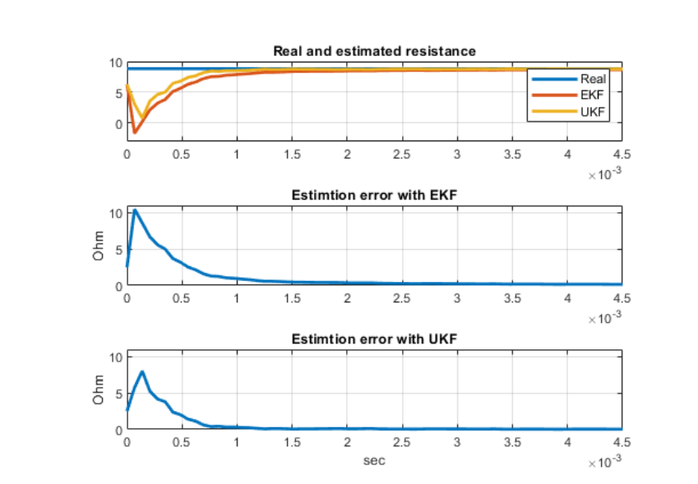
Resistance Estimation Results
Both EKF and UKF estimate resistance accurately
UKF outperforms EKF in convergence and error margin

Slide 18
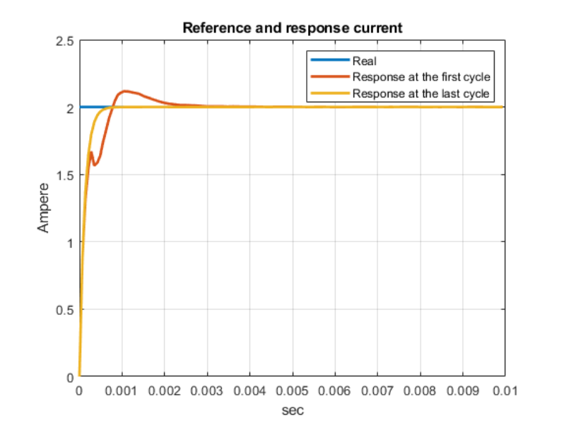
Current Response Results
Improved current tracking after estimation convergence
Adaptive controller enhances system response

Slide 19
Conclusions
Online estimation enables adaptive current control.
EKF and UKF are effective; UKF performs better.
Robust under dynamic conditions.
It may also be used to estimate the motor’s coil temperature.

